Slide 1
THERMODYNAMICS
ABDULLAHI D. KASSIM

Slide 2
Thermodynamics
In physics, thermodynamics deals with temperature, heat and their relation to energy, radiation, work, and properties of matter.
The energy can be of any forms such as electrical, mechanical, or chemical energy. William Thomson coined the term thermodynamics in 1749.
It is derived from two Greek words “thermes” meaning heat, and “dynamikos” meaning powerful.
When we say the word dynamic we think of motion or movement and energy. Thus, the term thermodynamics means heat movement or heat flow.

Slide 3
What is Thermodynamics?
Thermodynamics is the branch of physics which is concerned with the relationship between other forms of energy and heat. We can define thermodynamics as:
The branch of physics that deals with heat and temperature, and their relation to energy, work, radiation, and properties of matter.
To be specific, it explains how thermal energy is converted to or from other forms of energy and how matter is affected by this process.
Thermal energy is the energy that comes from heat. This heat is generated by the movement of tiny particles within an object. The faster these particles move, the more heat is generated.

Slide 4
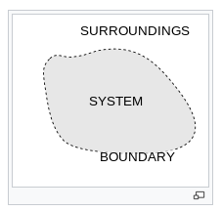
A System and Its Surroundings
In thermodynamics, it is imperative to define a system and its surroundings because that concept becomes the basis for many types of descriptions and calculations.
A primary goal of the study of thermochemistry is to determine the quantity of heat exchanged between a system and its surroundings.

Slide 5

The system is the part of the universe being studied, while the
surroundings are the rest of the universe that interacts with the system.
A system and its surroundings can be as large as the rain forests in South America or as small as the contents of a beaker in a chemistry laboratory. The type of system one is dealing with can have very important implications in chemistry because the type of system dictates certain conditions and laws of thermodynamics associated with that system.
The system is the part of the universe we wish to focus our attention on. In the world of chemistry, the system is the chemical reaction. For example:
2H₂ + O₂ ---> 2H₂O
The system consists of those molecules which are reacting.
The surroundings are everything else; the rest of the universe. For example, say the above reaction is happening in gas phase; then the walls of the container are part of the surroundings.

Slide 6
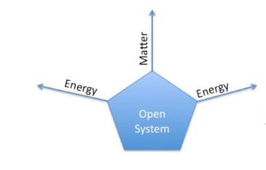
Open System
An open system is a system that freely exchanges energy and matter with its surroundings.
For instance, when you are boiling soup in an open saucepan on a stove, energy and matter are being transferred to the surroundings through steam.

Slide 7
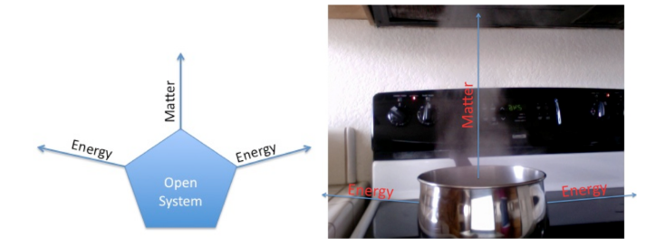
The saucepan is an open system because it allows for the transfer of matter (for example adding spices in the saucepan) and for the transfer of energy (for example heating the saucepan and allowing steam to leave the saucepan).

Slide 8
Closed System
Putting a lid on the saucepan makes the saucepan a closed system. A closed system is a system that exchanges only energy with its surroundings, not matter. By putting a lid on the saucepan, matter can no longer transfer because the lid prevents matter from entering the saucepan and leaving the saucepan. Still, the saucepan allows energy transfer. Imagine putting the saucepan on a stove and heating it. The saucepan allows energy transfer as the saucepan heats up and heats the contents inside it.
For example, when a lid is put a beaker, it becomes a closed system. Next, when the contents in the beaker are boiled, the sides of the beaker will start getting foggy and misty.

Slide 9
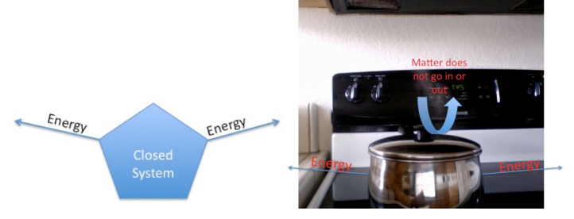
This fog and mist is the steam which covers the sides of the container because it cannot escape the beaker due to the lid. The fact that the beaker is able to produce this steam means that the beaker allows for energy transfer. Thus, even though a closed system cannot allow matter transfer, it can still allow energy transfer. The methods of energy transfer in a closed system are the same as those described for an open system above.

Slide 10
Isolated System
Now let's examine the type of system you have if you substituted a thermos for the saucepan. A thermos is used to keep things either cold or hot. Thus, a thermos does not allow for energy transfer. Additionally, the thermos, like any other closed container, does not allow matter transfer because it has a lid that does not allow anything to enter or leave the container. As a result, the thermos is what we call an isolated system.
An isolated system does not exchange energy or matter with its surroundings. For example, if soup is poured into an insulated container (as seen below) and closed, there is no exchange of heat or matter. The fact that, in reality, a thermos is not perfect in keeping things warm/cold illustrates the difficulty in creating an truly isolated system. In fact, there are a few, if any, systems that exist in this world that are completely isolated systems.

Slide 11
FIRST LAW OF THERMODYNAMICS
Energy cannot be created or destroyed it can only be transformed from one form to another i.e. energy is conserved.
The internal energy U of a system is the sum of all kinetic and potential energies of all its components.

Slide 12
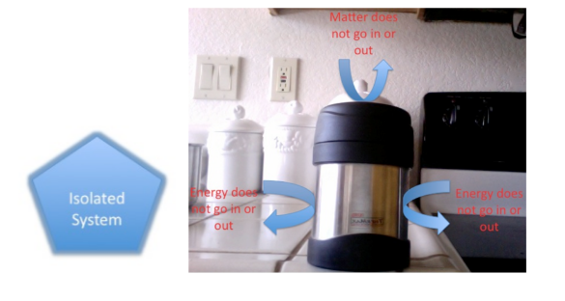

Slide 13
SYSTEM: an open system is one in which matter and energy can be exchanged with the surroundings.
An isolated system is one in which matter and energy cannot be exchanged with the surroundings.
Closed system is one that exchange energy but not matter with its surroundings.

Slide 14
State Functions Affecting Thermodynamics:
Internal energy (U)
Enthalpy (H)
Entropy (S)
Gibbs free energy (G)

Slide 15
SOME TERMS IN THERMODYMANICS
The change in internal energy ΔU is the difference between U final and U initial
A positive value ΔU indicates the system as gained energy from its surrounding,
A negative value of ΔU indicates that the system as lost energy to its surroundings.
ΔU = Q + W,
Q is the heat absorbed or evolved by the system.
U increases when work is done on a system or heat is added to a system.
Sign conventions for Q, W and ΔU.

Slide 16
SOME TERMS IN THERMODYMANICS
+Q = the system gains heat
—Q = the system losses heat
+w = work is done on the system
—w = work is done by the system
+ΔU = net gain of energy by the system
—ΔU= net loss of energy by the system An

Slide 17
Energy, Heat, and Work
In defining a system and its surroundings, words like energy and matter are used very often. As a result, one's understanding of a system and its surroundings can increase by understanding energy and matter. Energy is the ability to do work. Work is when an object moves against a force and is defined by the following equation:
with
W representing work,
F representing force, and
D representing distance.
It can be as simple as picking up a tennis ball or as complicated as pushing a car. When you are moving an object against a force (i.e. gravity), you are doing work on that object.

Slide 18
SOME TERMS IN THERMODYMANICS
An endothermic process is one in which the system absorbs heat while
An exothermic process is one that losses heat
A state function is the property of a system that is determined by specifying the system’s condition like temperature, pressure.
The value of a state function depends only on the present state and not the path the system took to attain the state.
Enthalpy H accounts for heat flow in processes occurring at constant pressure. No form of work is performed other than expansion /compression i.e. pressure – volume work.

Slide 19
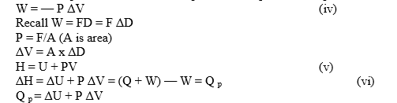
A positive value of ΔH implies that the system has gained heat and
A negative value of ΔH means the system has lost heat to the surrounding.
When a reaction is carried out in a constant value container, ΔV is zero.

Slide 20
Enthalpies of Reactions
The enthalpy change that accompanies a reaction is called the enthalpy of reaction.
A negative ΔH value means the reaction is exothermic; a positive ΔH value means the reaction is endothermic.
Enthalpy is an extensive property.
The magnitude of ΔH is directly proportional to the amount of reactant consumed in the process.
The enthalpy for a reaction is equal in magnitude, but opposite in sign, to ΔH for the reverse reaction.
The enthalpy change for a reaction depends on the state of the reactants and products.

Slide 21
What is thermodynamic process?
A thermodynamic process is a passage of a thermodynamic system from an initial to a final state of thermodynamic equilibrium.
Thermodynamics Timeline:
Thermodynamics has many sections under it and is considered as a broad subject because it deals with topics that exist all around us and thus classification becomes necessary.
Classical Thermodynamics:
In this section, the behaviour of matter is analyzed with a macroscopic approach. Units such as temperature and pressure are taken into consideration which helps the individuals to calculate other properties and to predict the characteristics of the matter that is undergoing the process.

Slide 22
Statistical Thermodynamics:
In this section, every molecule is under the spotlight i.e. the properties of each and every molecule and ways in which they interact are taken into consideration to characterize the behaviour of a group of molecules.
Pure Component Thermodynamics:
As the name itself states, this section tries to describe the behaviour of a system that has an unadulterated or pure constituent.
Solution Thermodynamics:
This section attempts to describe the behaviour of a system that contains more than one chemical in the mixture.

Slide 23
What are Laws of Thermodynamics?
The laws of thermodynamics define the fundamental physical quantities like energy, temperature and entropy that characterise thermodynamic systems at thermal equilibrium.
The laws represent how these quantities behave under various circumstances.
How many laws of thermodynamics are there?

Slide 24
There are four laws of thermodynamics and are given below:
Zeroth Law of Thermodynamics
First Law of Thermodynamics
Second Law of Thermodynamics
Third Law of Thermodynamics

Slide 25
Zeroth Law of Thermodynamics
The Zeroth Law is the basis for the measurement of temperature. It states that:
Two bodies which are in thermal equilibrium with a third body are in thermal equilibrium with each other.
Zeroth Law Of Thermodynamics Examples: consider two cups A and B with boiling water.
When a thermometer is placed in cup A, it gets warmed up by the water until it reads 100°C.
When it read 100°C, we say that the thermometer is in equilibrium with cup A.
Now when we move the thermometer to cup B to read the temperature, it continues to read 100°C.

Slide 26
The thermometer is also in equilibrium with cup B.
From keeping in mind the zeroth law of thermodynamics, we can conclude that cup A and cup B are in equilibrium with each other.
The zeroth law of thermodynamics enables us to use thermometers to compare the temperature of any two objects that we like.

Slide 27
First Law of Thermodynamics
The first law of thermodynamics which is also known as the conservation of energy principle states that:
Energy can neither be created nor destroyed, but it can be changed from one form to another.
This law may seem abstract but if we look at a few examples of the first law of thermodynamics, we will get a clearer idea.

Slide 28
First Law Of Thermodynamics Examples:
Fans convert electrical energy to mechanical energy.
Plants convert the radiant energy of sunlight to chemical energy through photosynthesis.
We eat plants and convert the chemical energy into kinetic energy while we swim, walk, breathe and when we scroll through this page.

Slide 29
Second Law of Thermodynamics
The second law of thermodynamics states that:
Energy in the form of heat only flows from regions of higher temperature to that of lower temperature.
Many individuals take this statement lightly and for granted, but it has an extensive impact and consequence. This is why it costs money to run an air conditioner. The human body obeys the second law of thermodynamics too.

Slide 30
Many individuals take this statement lightly and for granted, but it has an extensive impact and consequence. This is why it costs money to run an air conditioner. The human body obeys the second law of thermodynamics too.
Second Law Of Thermodynamics Examples
One of the examples of the second law of thermodynamics can be sweating in a crowded room. Assume yourself to be in a small room full of people. You are very likely to feel warm and start sweating. Sweating is a mechanism the human body uses to cool itself. Here, the heat from your body is transferred to sweat. As the sweat absorbs more and more heat from the body it evaporates and transfers heat to the surrounding air, thereby, heating up the temperature of the room.

Slide 31
Third Law of Thermodynamics
The Third Law states that:
The entropy of a perfect crystal is zero when the temperature of the crystal is equal to absolute zero (0 K)
Entropy is sometimes called “waste energy” i.e., the energy that is unable to do work, and since there is no heat energy whatsoever at absolute zero, there can be no waste energy.

Slide 32
Third Law Of Thermodynamics Examples:
Let us consider steam as an example to illustrate the third law of thermodynamics step by step:
We know that steam is a gaseous state of water at higher temperatures. In this state:
1. The molecules within it move freely and have high entropy.
2. If one decreases the temperature below 100°C, the steam gets converted to water, where the movement of molecules is restricted, decreasing the entropy of water.
3. When water is further cooled below 0°C, it gets converted to solid ice. In this state, the movement of molecules is further restricted and the entropy of the system reduces more.
4. As the temperature of the ice further reduces, the movement of the molecules in them are restricted more and the entropy of the substance goes on decreasing.
5. When the ice is cooled to absolute zero, ideally the entropy should be zero. But in reality, it is impossible to cool any substance to zero.

Slide 33
References
Petrucci, et al. General Chemistry Principles & Modern Applications. 9th ed. Upper Saddle River, NJ: Pearson Prentice Hall, 2007
Gonick, Larry; Criddle, Craig. The Cartoon Guide to Chemistry. 1st ed. New York, NY: Harper Collins Publishers Inc., 2005
Moore, John T.;Langley, Richard. Chemistry for the Utterly Confused. New York, NY: McGraw-Hill, 2007

